Slide 1
18CSC304J COMPILER DESIGN
UNIT 5
SESSIONS 1&2

Slide 2
Topics that will be covered
Code Optimization
Principal Sources of Optimization
Function Preserving Transformations
Loop Optimization

Slide 3
CODE OPTIMIZATION

Slide 4
Introduction
The code optimization phase attempts to improve the intermediate code, so that faster-running machine code will result
Compilers that apply code-improving transformations are called optimizing compilers

Slide 5
Criteria for Code-Improving Transformations
The best program transformations are those that yield the most benefit for the least effort
Properties of transformations:
A transformation must preserve the meaning of programs. That is, an optimization must not change the output produced by a program for a given input, or cause an error such as division by zero that was not present in the original version of the source program
A transformation must speedup programs by a measurable amount
A transformation must be worth the effort

Slide 6
Getting Better Performance
Dramatic improvements in the running time of a program can be obtained by improving the program at all levels from finding a better algorithm to implementing the algorithm
Algorithmic transformations can produce spectacular improvements in running time
For example, the running time of a program for sorting N elements is 2.02 N² microseconds for Insertion sort and 12Nlog₂N microseconds for quicksort.
For N=100, the speedup is a factor of 2.5.
For N=100,000 the speedup is a factor of more than a thousand
A compiler cannot find the best algorithm for a given program.
But it can replace a sequence of operations by an algebraically equivalent sequence so as to reduce the running time of a program
It is the compiler’s responsibility to make good use of the machine’s resources. For example, keeping the most heavily used variables in registers can cut running time significantly
So, getting better performance is the responsibility of both the programmer and the compiler

Slide 7
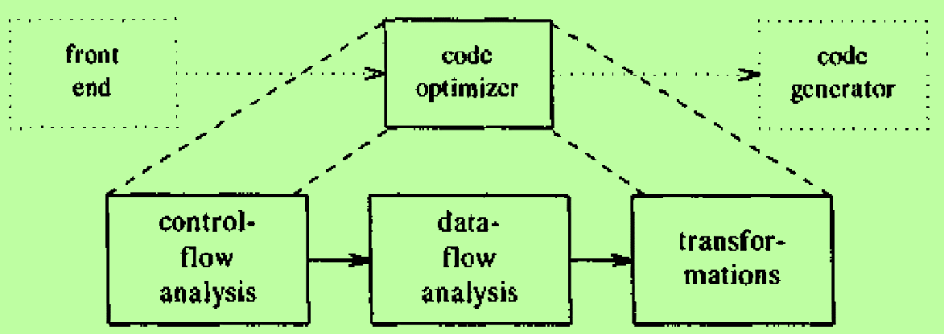
Organization of an Optimizing Compiler
Transformations can be done on intermediate code using the organization shown below:
The code improvement phase consists of control-flow and data-flow analysis followed by the application of transformations
In the code optimizer, programs are represented by flow graphs, in which edges indicate the flow of control and nodes represent basic blocks
Advantages of the above organization:
The operations needed to implement high-level constructs are made explicit in the intermediate code, so it is possible to optimize them
The intermediate code can be independent of the target machine, so the optimizer does not have to change much if the code generator is replaced by one for a different machine

Slide 8
PRINCIPAL SOURCES OF OPTIMIZATION

Slide 9
The Principal Sources of Optimization
A transformation of a program is called local if it can be performed by looking only at the statements in a basic block. Otherwise it is called global
Many transformations can be performed at both the local and global levels
Local transformations are usually performed first
Function-Preserving Transformations
Examples for function-preserving transformations are
Common subexpression elimination
Copy Propagation
Dead-code elimination
Constant Folding
The other transformations come up primarily when global optimizations are performed.

Slide 10
FUNCTION PRESERVING TRANSFORMATIONS

Slide 11
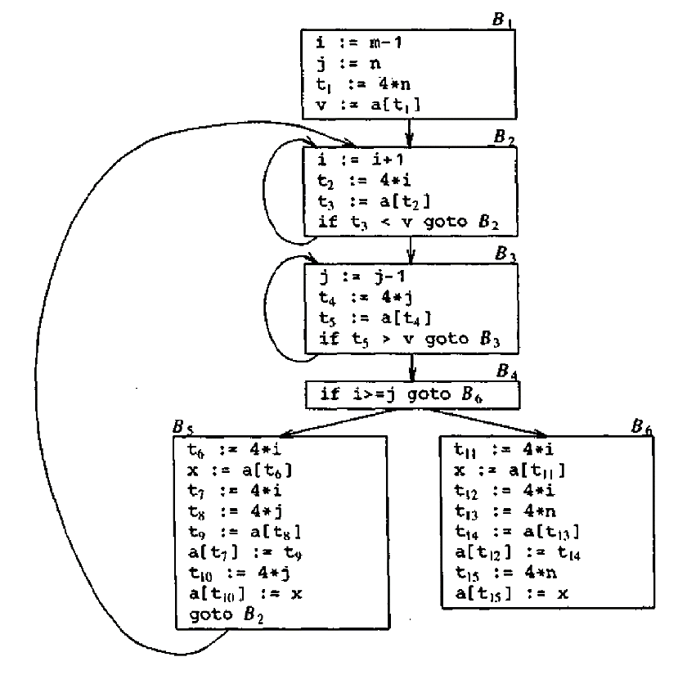
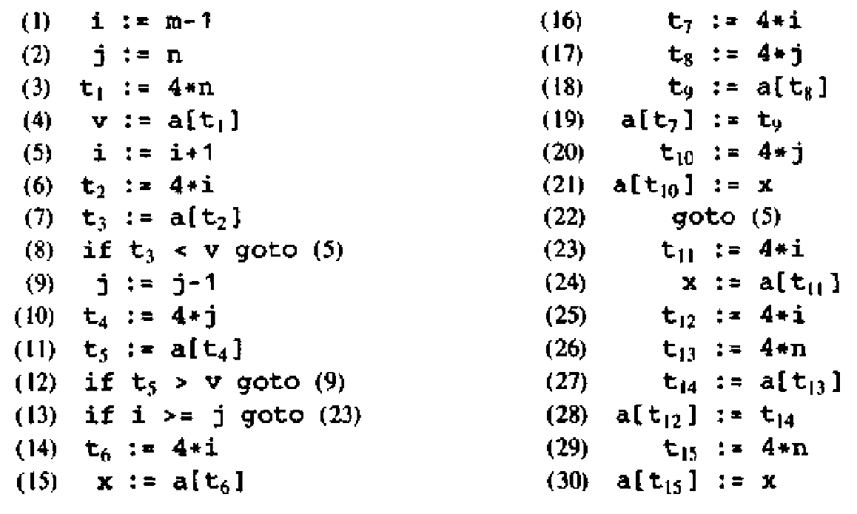
Example
FLOW GRAPH
Three-address code for quick sort

Slide 12
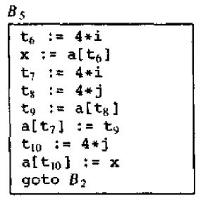
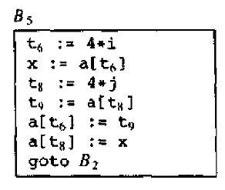
1. Common Subexpression Elimination
Before
An occurrence of an expression E is called a common subexpression if E was previously computed and the values of variables in E have not changed since the previous computation
We can avoid recomputing the expression if we can use the previously computed value
Local Common subexpression Elimination
Consider the block B5
The assignment t7=4*i is the same as the assignment t6=4*i
The assignment t10=4*j is the same as the assignment t8=4*j
These common subexpressions can be eliminated by changing the block as shown
Global Common subexpression Elimination
The expressions t6=4*i and t8=4*j in block B5 compute the same values as the expressions t2=4*i in B2 and t4=4*j in B3
Eliminate those subexpressions also
After

Slide 13
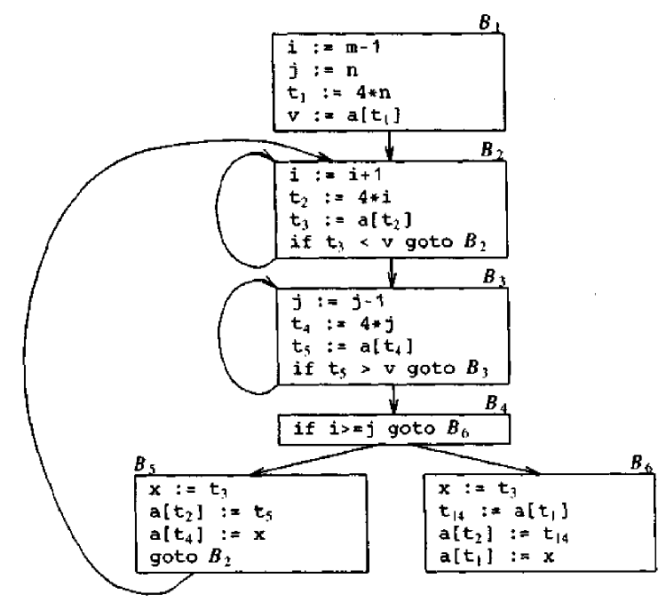
Common Subexpression Elimination
After eliminating all local and global common subexpressions, the flowgraph becomes

Slide 14
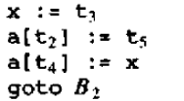
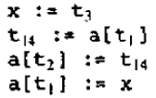
2. Copy Propagation
The algorithm for eliminating common subexpressions introduces some copy statements
Assignments of the form f:=g are called copy statements.
The idea behind copy propagation transformation is to use g for f wherever possible after the copy statement f:=g
Applying copy propagation to blocks B5 and B6 yields
The advantage of copy propagation is that it often turns the copy statement into dead-code, which can be eliminated
Block B5
x := t3
a[t2] := t5
a[t4] := t3
goto B2
Block B6
x := t3
t14 := a[t1]
a[t2] := t14
a[t1] := t3

Slide 15
3. Dead-Code Elimination
A variable is live at a point in a program if its value can be used subsequently, otherwise it is dead at that point
Dead-code is a statement that computes a value that never gets used
For example, in blocks B5 and B6, the statements x:=t3 is dead-code, because the value of x is not used. So it can be eliminated
Dead-codes can be found by performing data flow analysis
Block B5
x := t3
a[t2] := t5 a[t2] := t5
a[t4] := t3 a[t4] := t3
goto B2 goto B2
Block B6
x := t3
t14 := a[t1] t14 := a[t1]
a[t2] := t14 a[t2] := t14
a[t1] := t3 a[t1] := t3

Slide 16
4. Constant Folding
Deducing at compile time that the value of an expression is a constant and using the constant instead of the expression is known as constant folding
For example, consider the statement
if (debug) print……
By a data flow analysis, it may be possible to deduce that each time the program reaches this statement, the value of debug is false
If constant folding replaces debug by false, then the print statement is dead and it can be eliminated

Slide 17
LOOP OPTIMIZATIONS

Slide 18
LOOP OPTIMIZATIONS
Loops, especially the inner loops are the very important place for optimizations, because programs spend bulk of their time there
The running time of a program can be improved if we decrease the number of instructions in an inner loop, even if we increase the amount of code outside that loop
Three important loop optimization techniques are
Code Motion
Induction variable elimination
Reduction in strength

Slide 19
1. Code Motion
This transformation takes an expression that yields the same result independent of the number of times a loop is executed (a loop-invariant computation) and places the expression before the loop
For example, consider the following while statement
while(i<=limit-2)
{
statements that does not change limit
}
Code motion will result in the equivalent of
t=limit-2;
while(i<=t)
{
statements that does not change limit
}
The evaluation of limit-2 is a loop-invariant computation

Slide 20
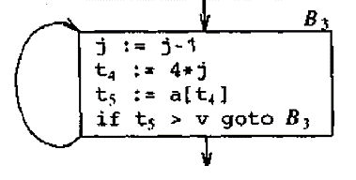
2. Induction Variables & 3. Reduction in Strength
Consider the loop around block B3
The values of j and t4 remain in lock-step, i.e., every time the value of j decreases by 1, the value of t4 decreases by 4 because t4=4*j. Such identifiers are called induction variables
When there are two or more induction variables in a loop, it may be possible to get rid of all but one, by the process of induction variable elimination
Now again consider the loop around block B3.
j and t4 are induction variables, because, every time the value of j decreases by1, the value of t4 decreases by 4 and t4 is not changed in the loop

Slide 21
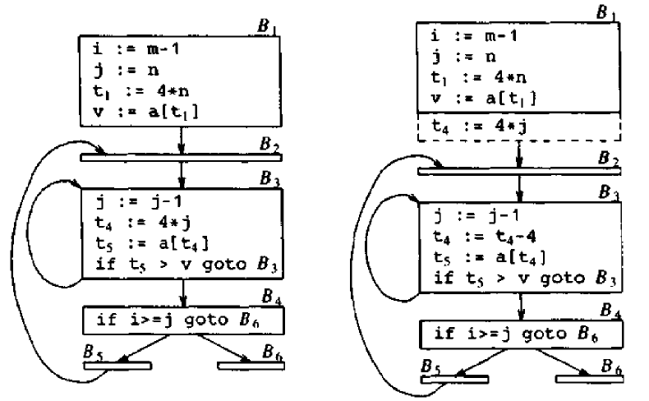
2. Induction Variables & 3. Reduction in Strength – cont..
We can replace the assignment t4:=4*j by t4:=t4-4
The only problem is that t4 does not have a value when we enter block B3 for the first time
Because we must maintain the relationship t4:=4*j
So, we place an initialization of t4 at the end of the block B1
Before transformation
After transformation

Slide 22
2. Induction Variables & 3. Reduction in Strength – cont..
The replacement of a multiplication by a subtraction will speed up the object code if multiplication takes more time than addition or subtraction, as is the case on many machines
In block B2, i and t2 are induction variables
Whenever i increases by 1, t2 increases by 4
Applying reduction in strength
The values of i and t2 satisfy the relationship t2=4*i
The values of j and t4 satisfy the relationship t4=4*j
So the test i>=j is equivalent to t2>=t4
If we make this change in block B4
Then i in block B2 and j in block B3 become dead variables and the assignments to them become dead code that can be eliminated
Block B2
i := i+1 i := i+1
t2 := 4*i t2 := t2+4
t3 := a[t2] t3 := a[t2]
if t3<v goto B2 if t3<v goto B2
Block B4
if i>=j goto B6 if t2>=t4 goto B6

Slide 23
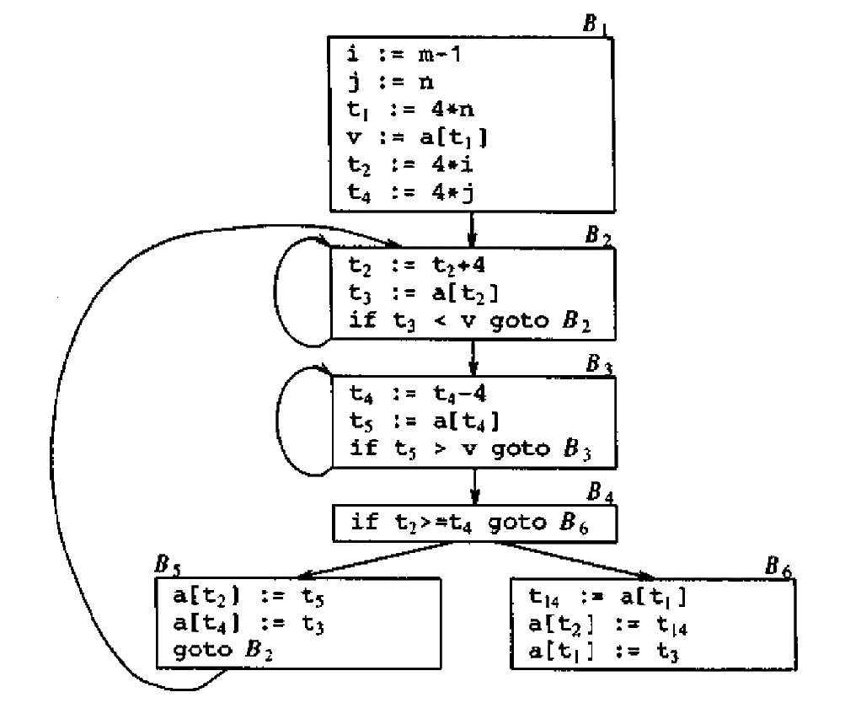
2. Induction Variables & 3. Reduction in Strength
After elimination of all induction variables

